Slide 1
Genome assembly and annotation of ESCherichia coli
By: fIONA shavilof

Slide 2
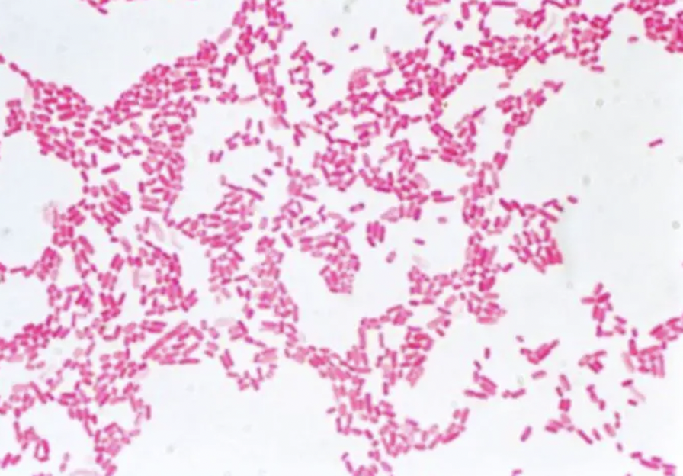
Introduction:
Purpose: To perform a genome assembly and annotation of E.coli and to see if its pathogenic and what antibiotic resistance genes it may contain.
E.coli is a gram negative, rod-shaped bacteria that belongs to the Enterobacteriaceae family.
Most strain of E.coli are harmless and are found in the gut microbiome of humans and animals.

Slide 3
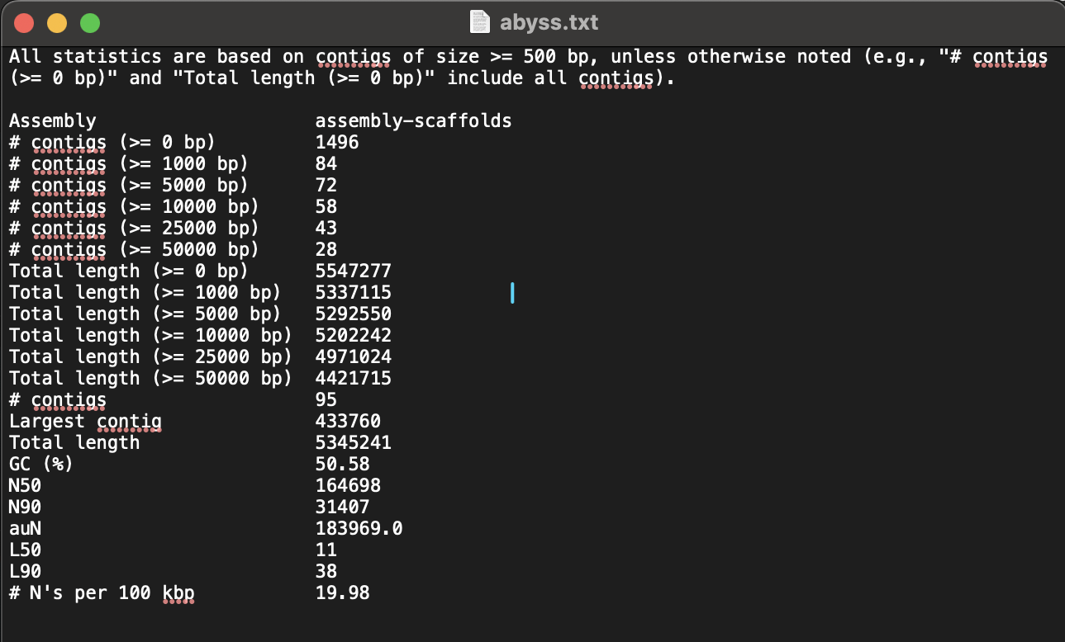
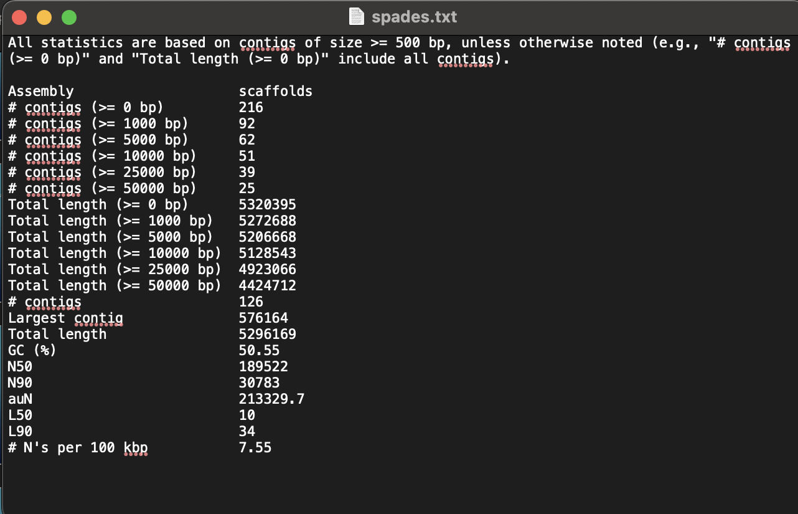
Methods: CODE TO ASSEMBLE: spades.py -1 SRR33420661_1.fastq -2 SRR33420661_2.fastq -o spadesout abyss-pe name=assembly k=96 B=2G in='SRR33420661_1.fastq SRR33420661_2.fastq’ cODE TO PRODUCE A SUMMARY: quast.py spadesout/scaffolds.fasta -o quastspades quast.py abyssout/assembly-scaffolds.fa -o quastabyss
ABYSS ASSEMBLY
sPADES ASSEMBLY

Slide 4
code to create 16s rRNA sequence: barrnap --kingdom bac spadesout/scaffolds.fasta > rRNAsequences.gff CODE TO CREATE fasta output file: bedtools getfasta -fi spadesout/scaffolds.fasta -bed rRNAsequences.gff -fo rRNAsequences.fasta
METHODS:

Slide 5
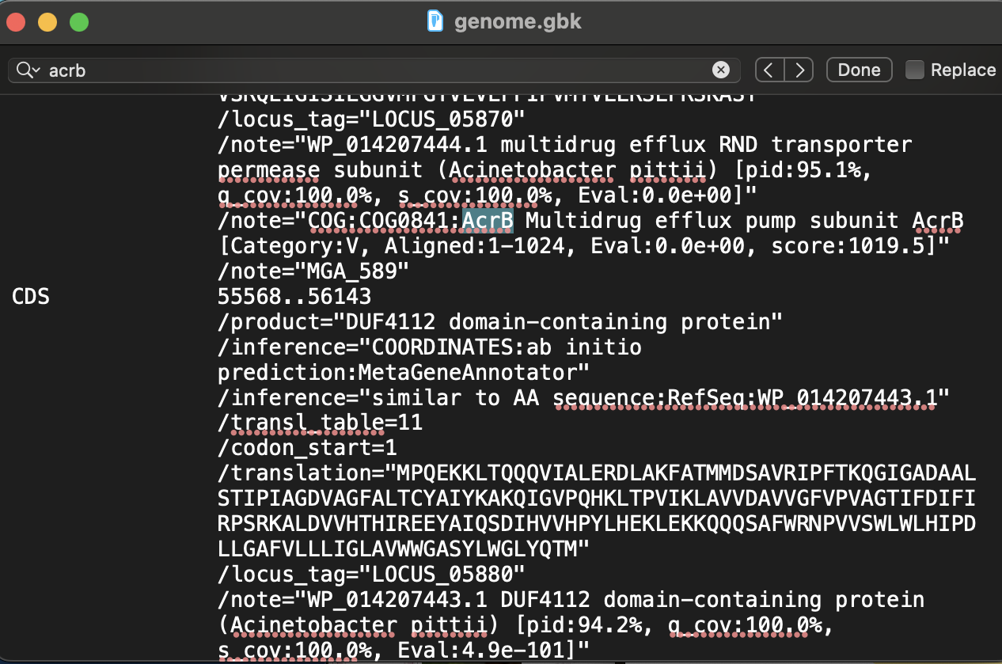
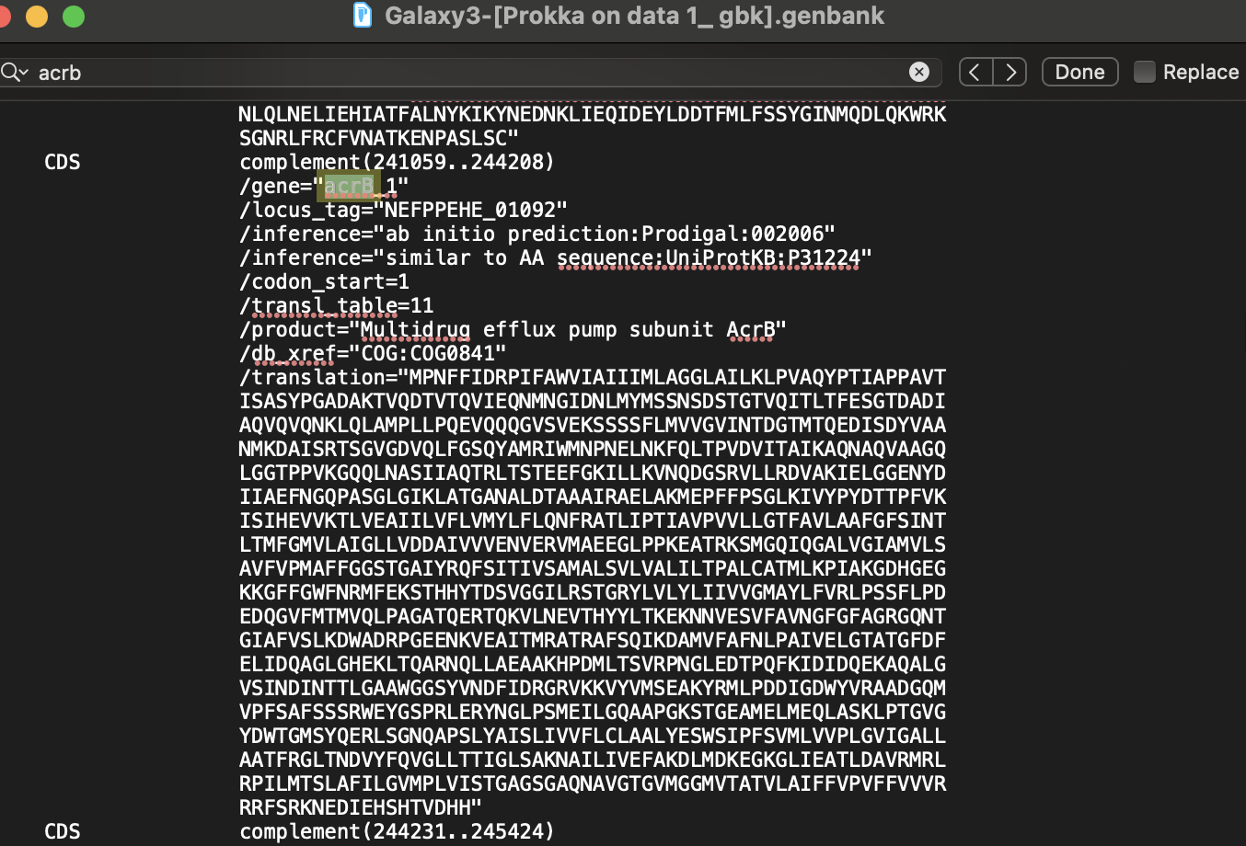
Methods:
DFAST
Prokka

Slide 6


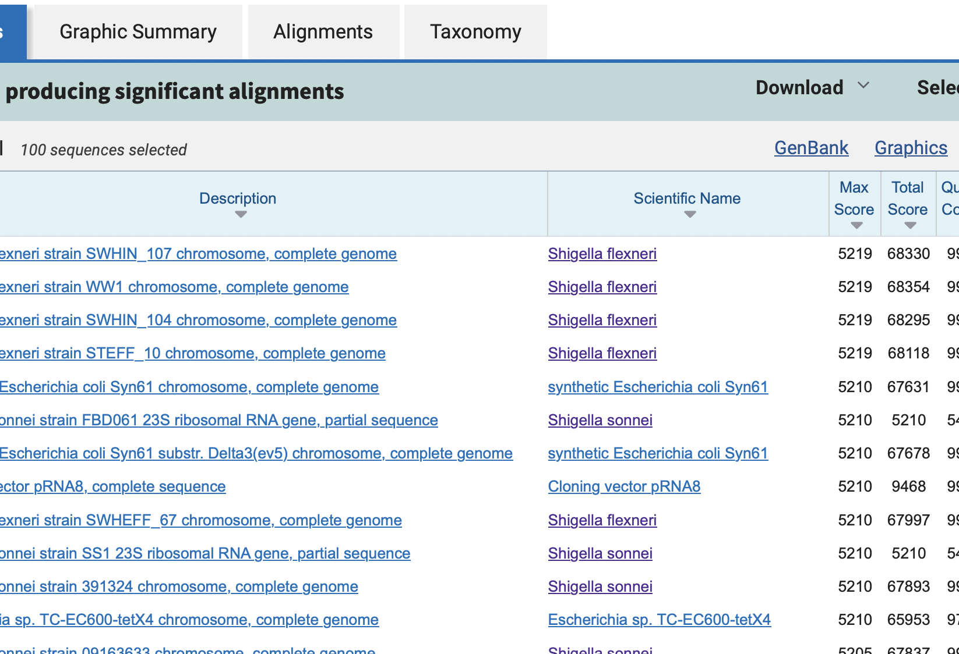
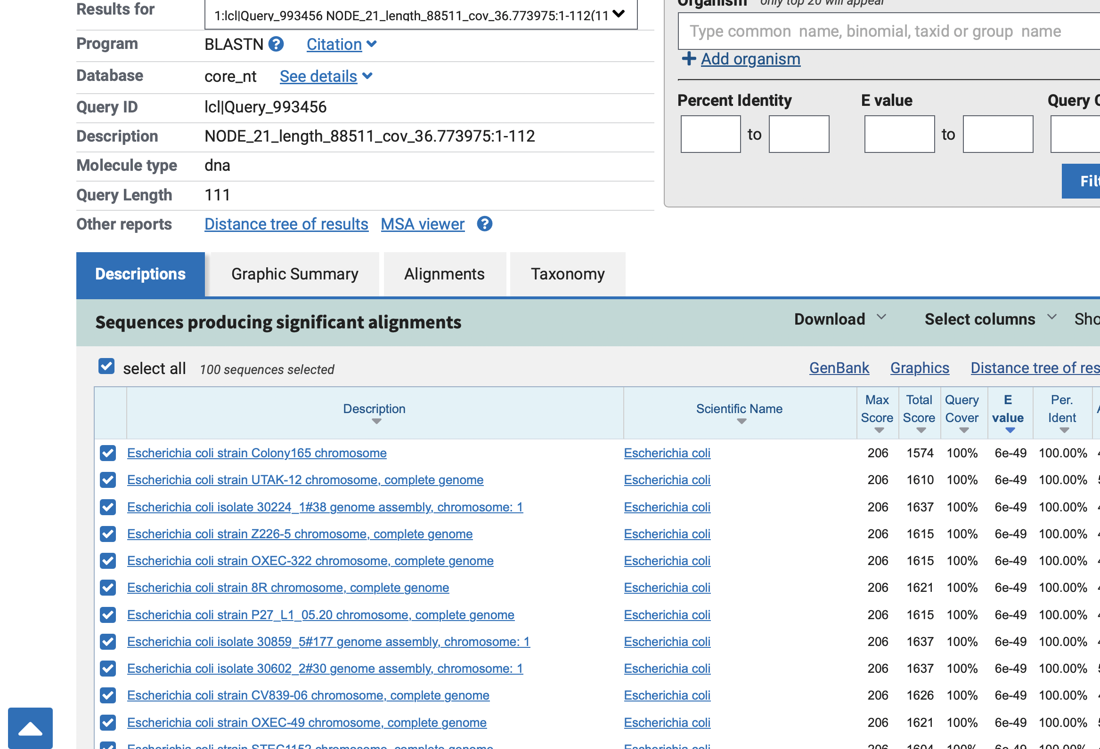
Results: blast
Confirmed I was dealing with E.coli.
Closest relatives were S. flexneri & S. sonnei.

Slide 7
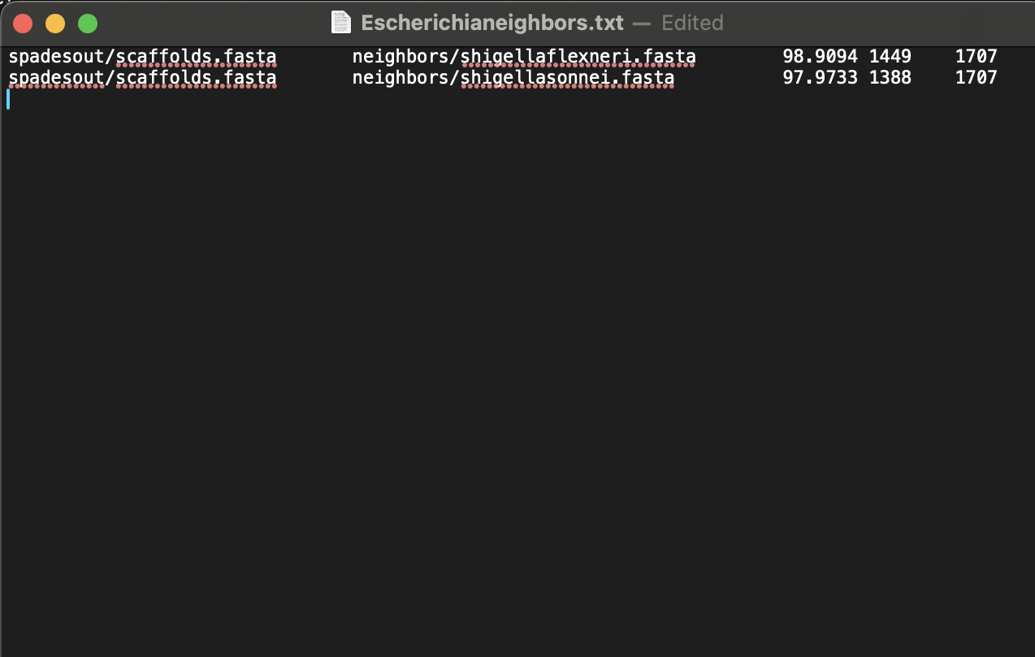
RESULTS:
fastANI
Results showed that both the species are similar to E.coli.
fastANI % for both are over 95%.

Slide 8
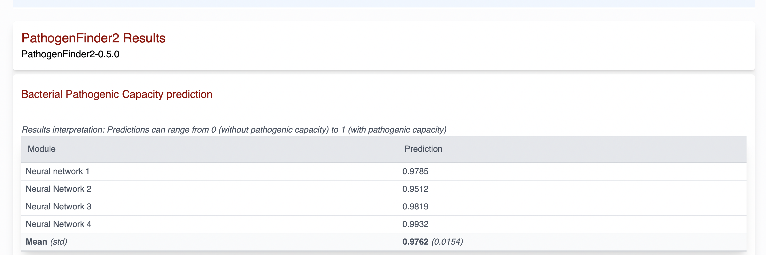
Results:

Slide 9
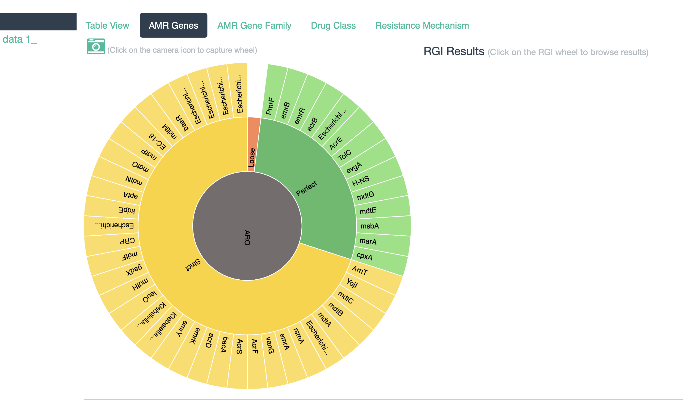
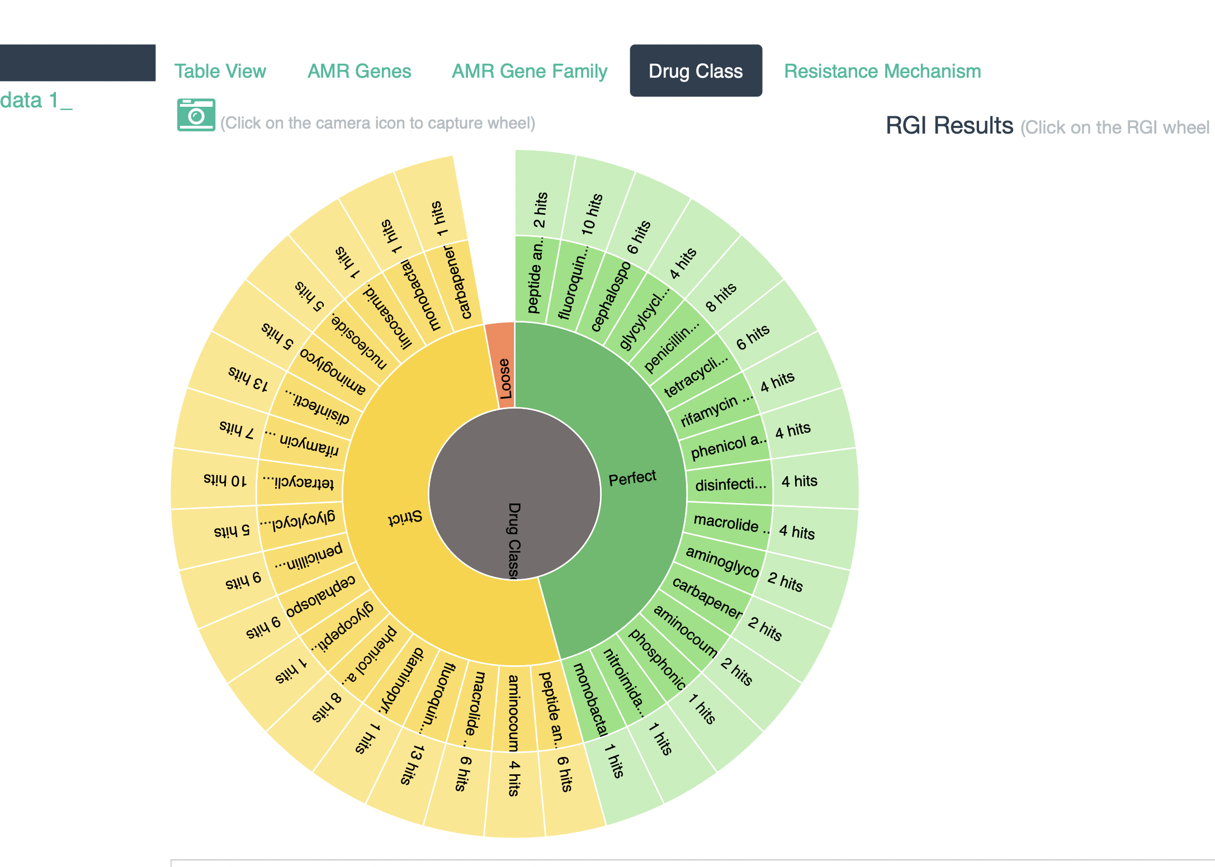
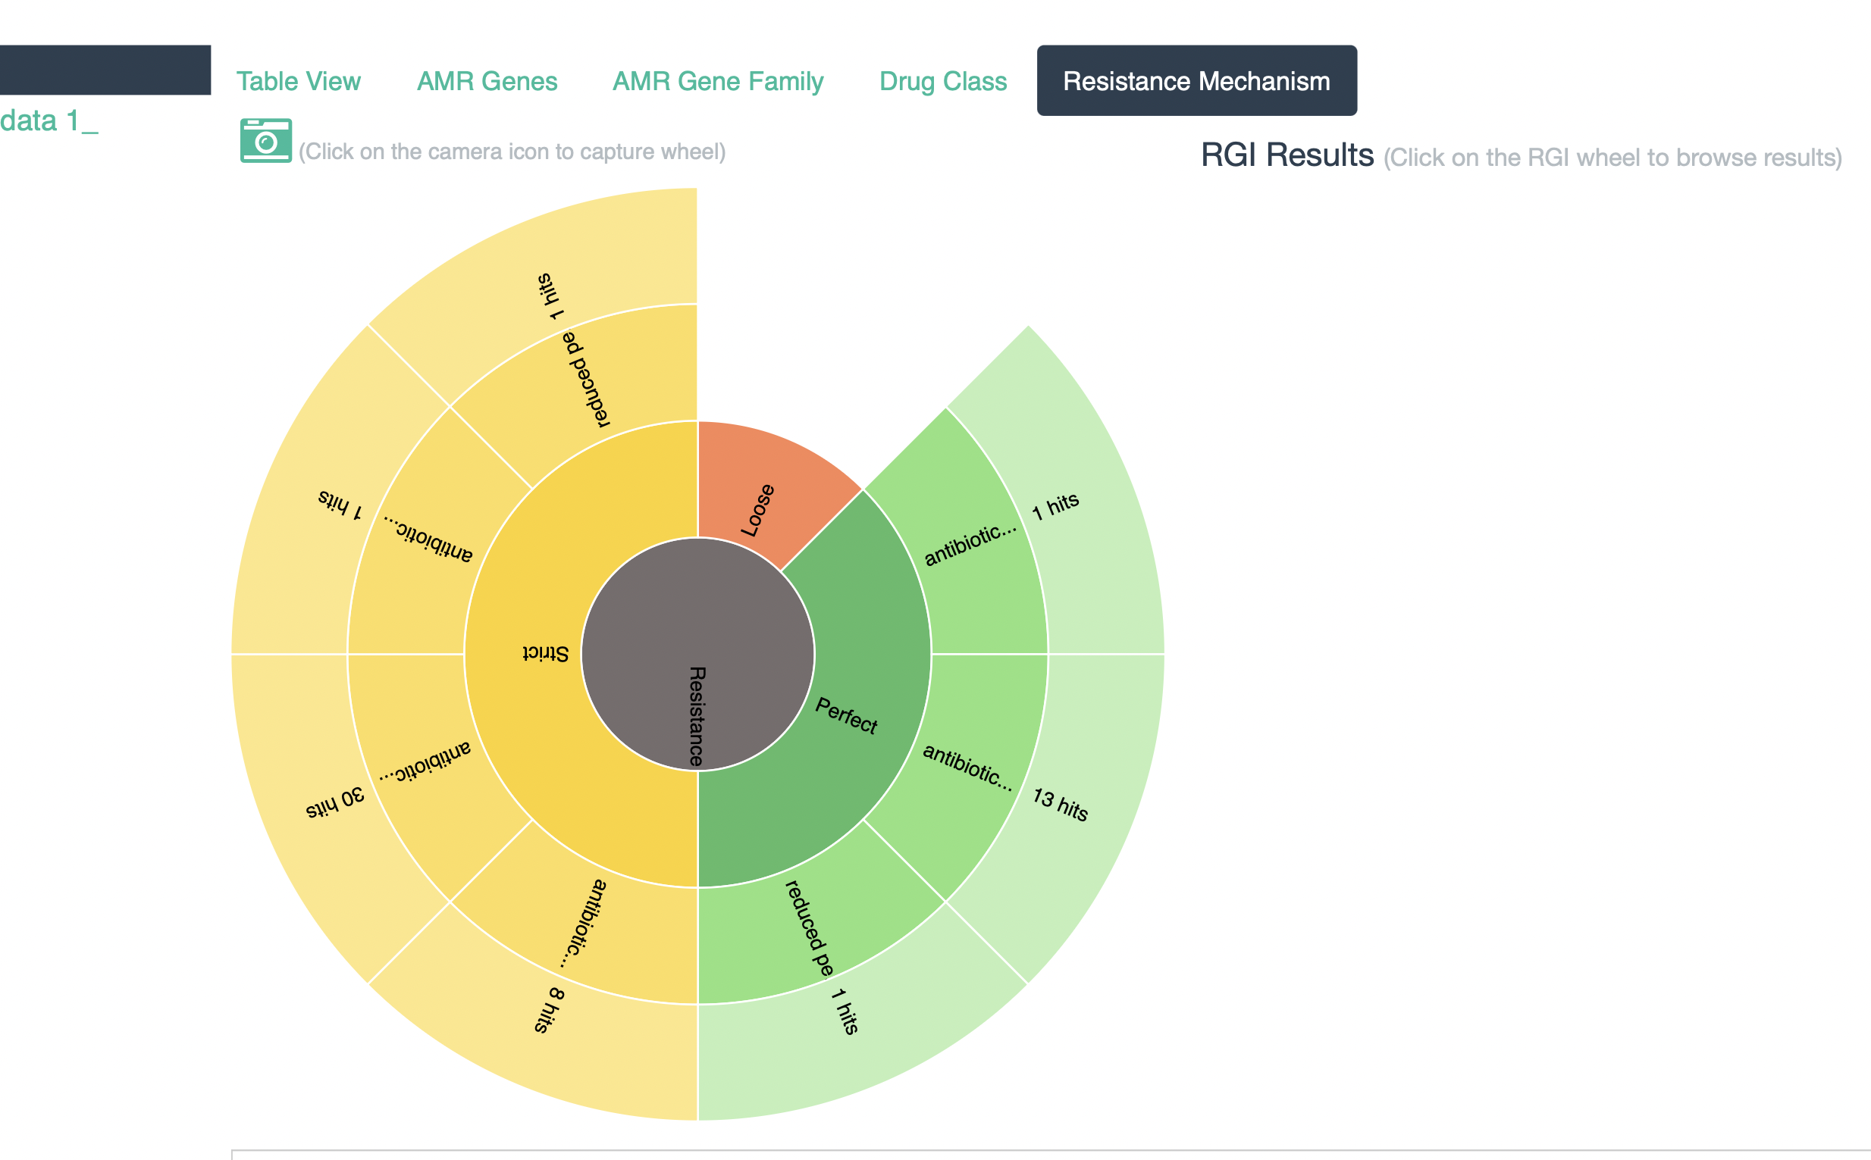
RESULTS: CARD (Comprehensive antibiotic resistance database)
Antibiotic
Resistance mechanism
antibiotic RESISTANCE GENES
PmrF, acrB, & marA
Fluroquinolone, penicillin beta-lactam, & tetracycline.
Antibiotic efflux, antibiotic target alteration, & reduced permeability to antibiotic

Slide 10
CONCLUSION
Confirmed I was working with E.coli, WITH THE CLOSEST RELATIVES BEING s. FLEXNERI & S. sonnei.
PATHOGENFINDER2 CONFIRMED IT WAS HIGHLY PATHOGENIC.
CARD SHOWED E.COLI CONTAINED MULTIPLE ANTIBOITIC RESISTANT GENES.

Slide 11
REFERENCE:
For picture
BNO team. (2024). E. Coli Under The Microscope. Biology Notes Online. https://biologynotesonline.com/e-coli-under-the-microscope/

